Slide 1
Iteration 5
Team Swiftriver
(Trisia Baltazar, Adrian Boone, Chad Daily, Jann Jalando-on, Mate Kovacs, Joseph Morrison)

Slide 2
Agenda
Class Diagram
ERD
Windows navigation diagram
Data tables example
Prototypes
Homepage
Login/ Register
Profile
Donation Page
Camper Record
Events
Volunteer Page
Silent Auction Page
Conclusion

Slide 3
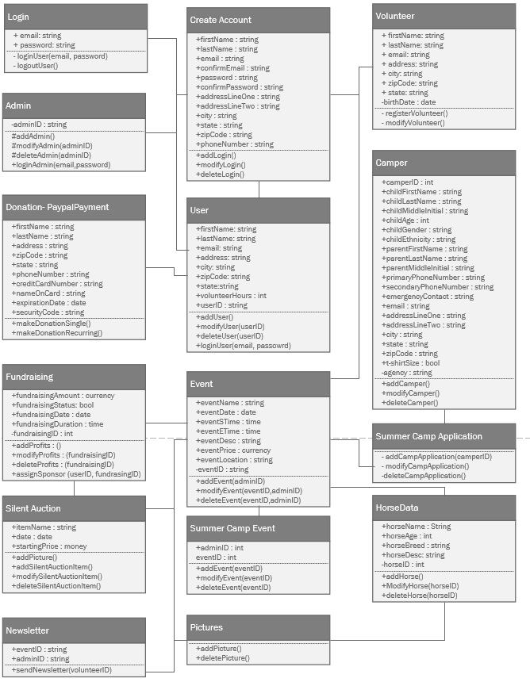
Class Diagram

Slide 4
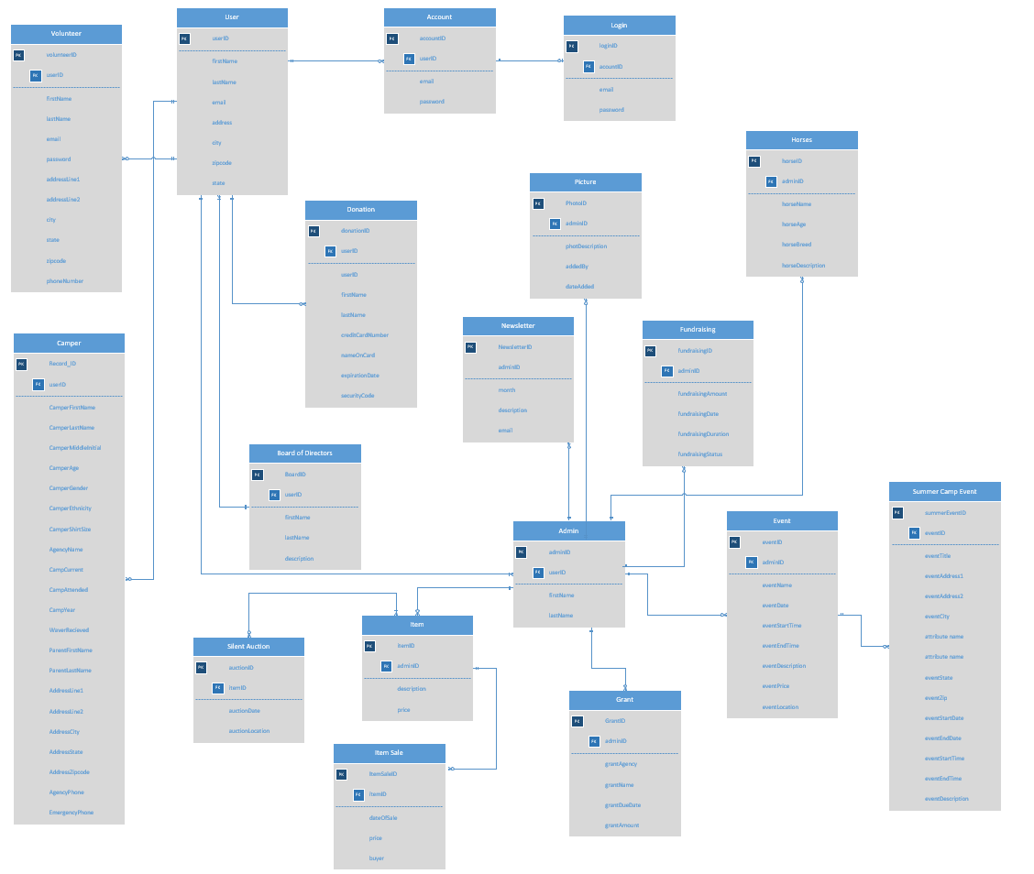
ERD

Slide 5
Navigation Diagram & Screen Layout
The navigation diagram is a visual representation of the users’ flow through the system
The diagram flows downward, step by step, one window at a time
The diagram depicts common human-computer interaction paths

Slide 6
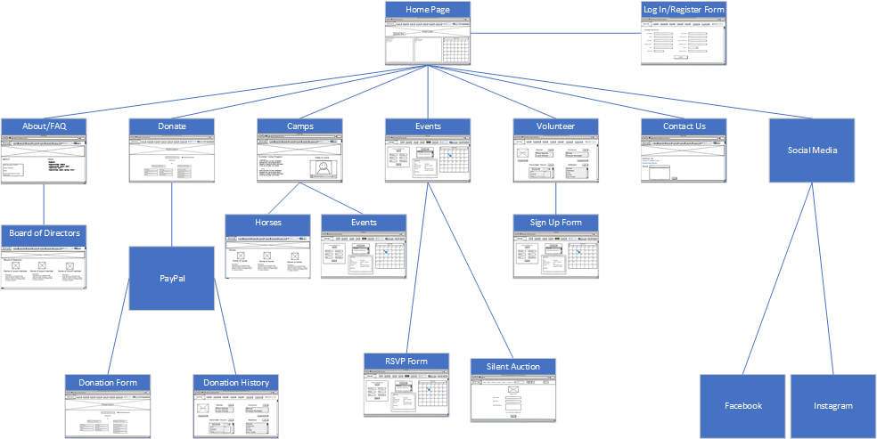

Slide 7
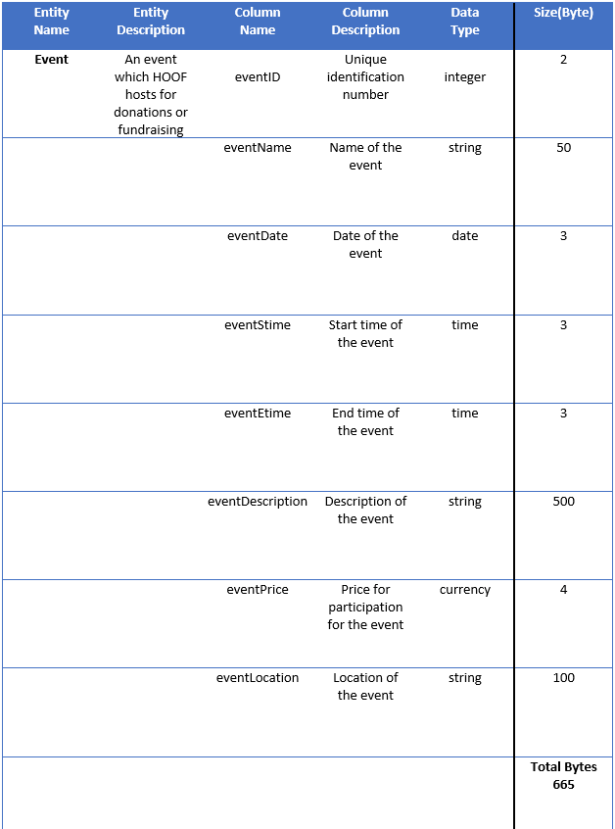
Data Dictionary
The Data dictionary displays data that the website will generate and use to function
Description of Entry
Attributes
Description of Attribute
Data type
Size in bytes

Slide 8
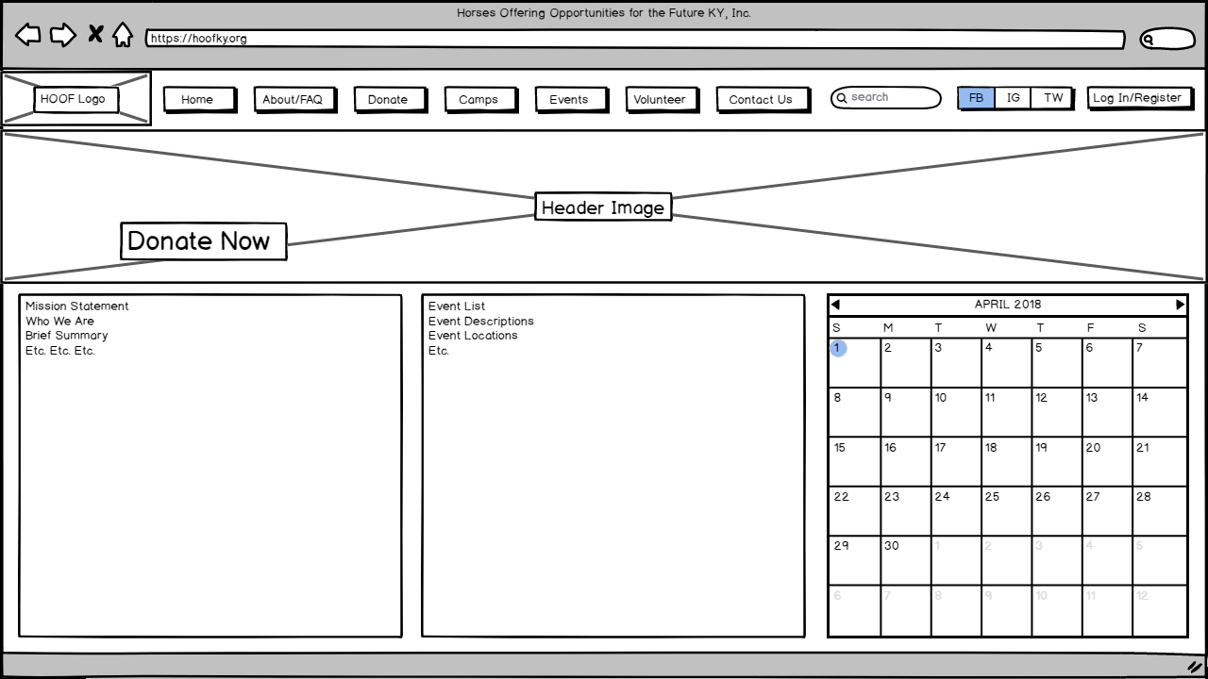
Homepage
Allows for redirection to all HOOF KY user interactions
Login/Register
Donations
Events
News
Social Media
Contact

Slide 10
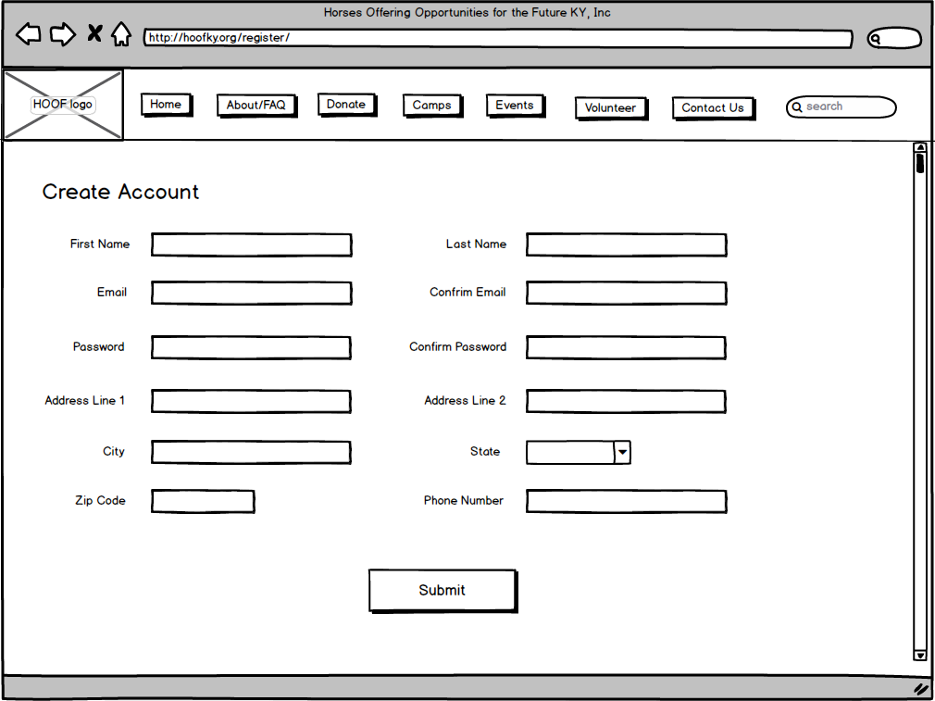
Login/Register
Allows users to create an account
Receive HOOF News
Volunteer Opportunities
Easier communication with HOOF
Retention for HOOF

Slide 12
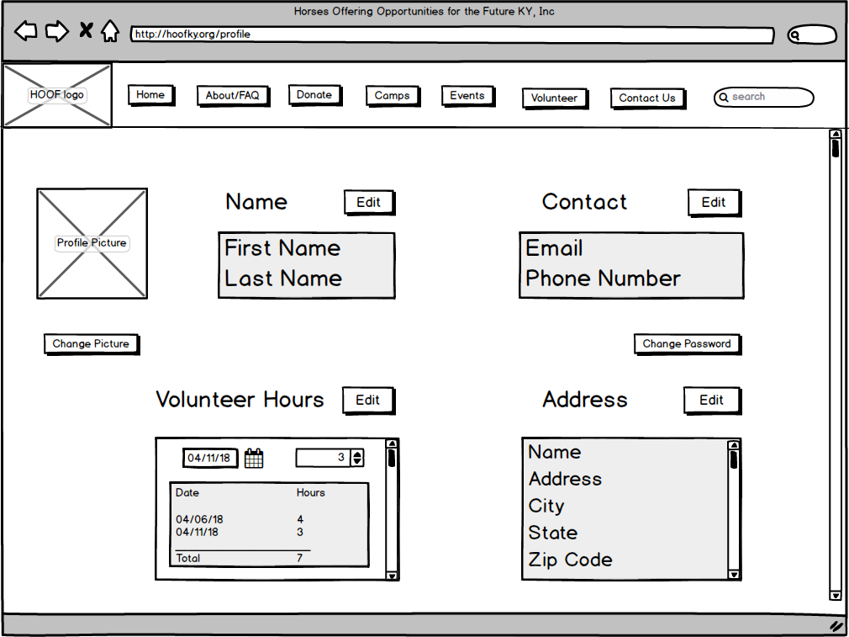
Profile
Allows a volunteer to make changes to their profile information
Ensures information is always up to date
Enables volunteer to edit hours

Slide 14
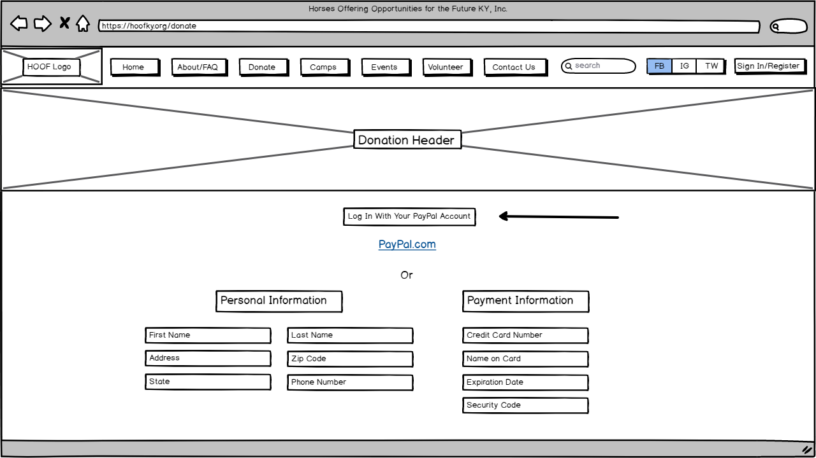
Donation
Allows users to donate
One time
PayPal
Credit Information
Recurring
PayPal
Credit Information

Slide 16
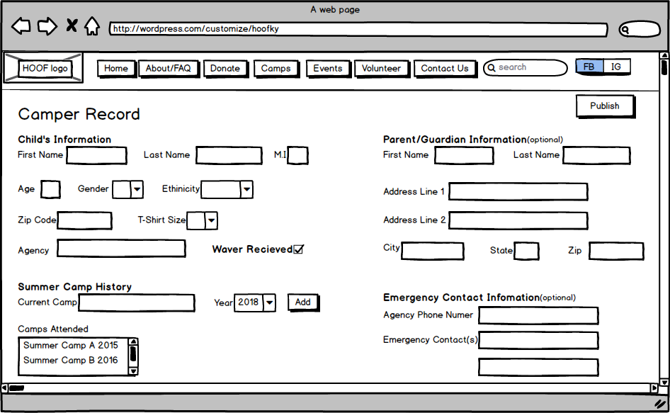
Camper Record
Allows admin to add and modify:
Camper’s personal information
Camper’s camp history
Parent/Guardian information (optional)

Slide 18
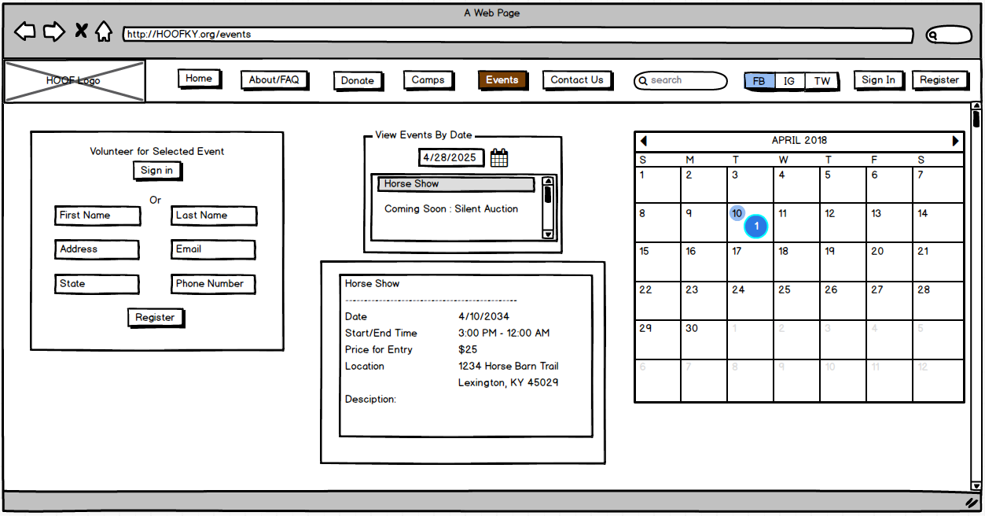
Events
Allows all users to:
View calendar of Events
Ongoing events
Upcoming events
View details of events
Sign up for event

Slide 20
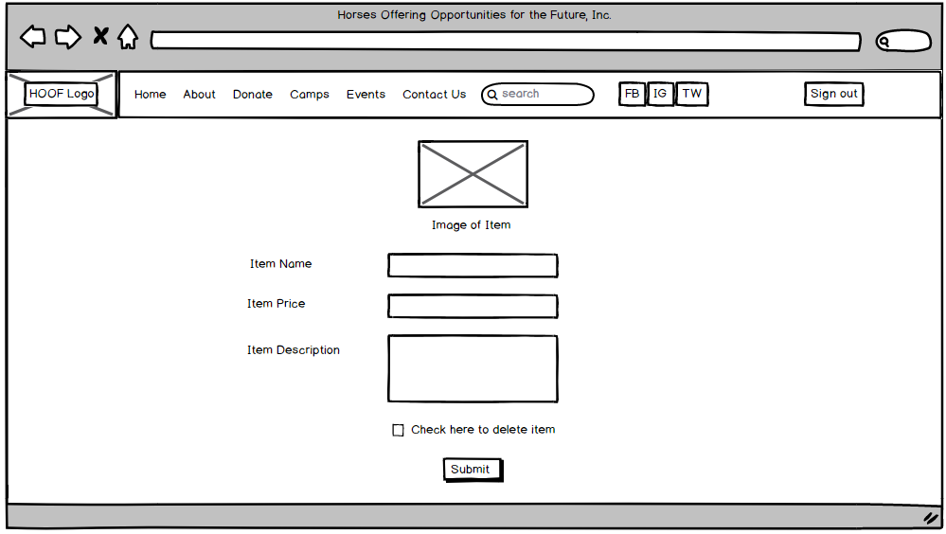
Silent Auction
Allows admin to add, modify, and delete:
Item picture
Item name
Item price
Item description

Slide 22
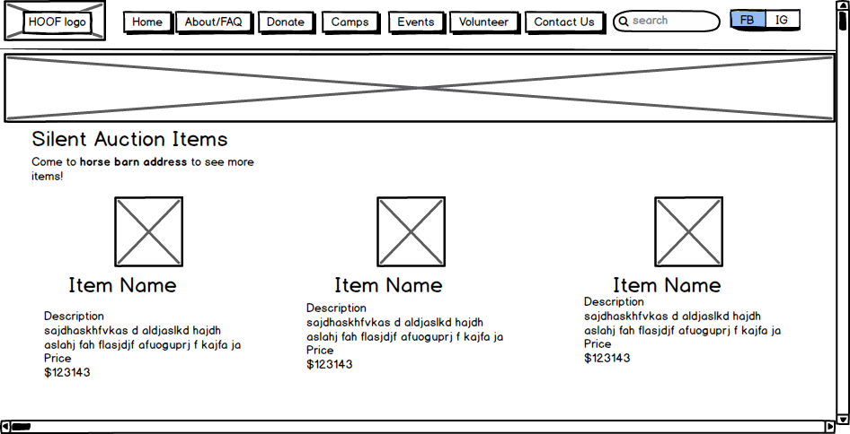

Slide 23
Conclusion
To wrap up, we’ve covered:
Class Diagram
ERD
Navigation Diagram
Data Dictionary
Prototypes
Any Questions?

